Slide 1
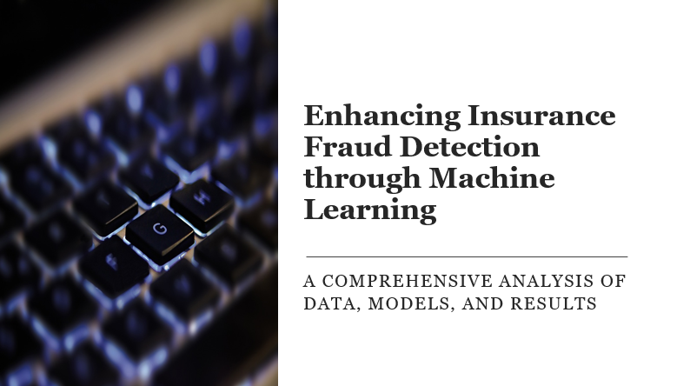



Slide 2


Table of contents
Machine Learning in Insurance Fraud Detection … 3
Dataset Overview … 4
Data Summary … 5
Univariate Analysis … 6
Bivariate Analysis … 7
Multivariate Analysis … 8
Data Preprocessing … 9
Model Selection … 10
Results … 11
Conclusion … 12
References … 13

Slide 3


Machine Learning in Insurance Fraud Detection
Overview of the insurance fraud problem in the auto insurance sector
Insurance fraud is a significant issue in the auto insurance sector, costing billions of dollars annually.
Fraudulent claims can take many forms, including staged accidents, exaggerated claims, and false information.
The impact of fraud is far-reaching, leading to higher premiums for honest policyholders.
Overview of the insurance fraud problem in the auto insurance sector
Insurance fraud is a significant issue in the auto insurance sector, costing billions of dollars annually.
Fraudulent claims can take many forms, including staged accidents, exaggerated claims, and false information.
The impact of fraud is far-reaching, leading to higher premiums for honest policyholders.
Importance of machine learning in detecting fraudulent claims
Machine learning algorithms can analyze vast amounts of data to identify patterns and anomalies.
These technologies can improve the accuracy and efficiency of fraud detection.
Implementing machine learning can lead to significant cost savings and better resource allocation.

Slide 4

Dataset Overview
Description of the dataset
Includes insurance policy details, client information, and accident specifics.
Provides a comprehensive view of the factors involved in insurance claims.
Key statistics
Consists of 1000 entries capturing various scenarios.
Contains 40 columns with diverse data points for analysis.

Slide 5
Data Summary
Summary Statistics
Mean age of insured: 38 years
Median income: $50,000
25th percentile for vehicle year: 2015
75th percentile for total claim amount: $5,000
Distribution of Target Variable “fraud_reported”
Fraudulent claims: 300 (30%)
Non-fraudulent claims: 700 (70%)

Slide 6
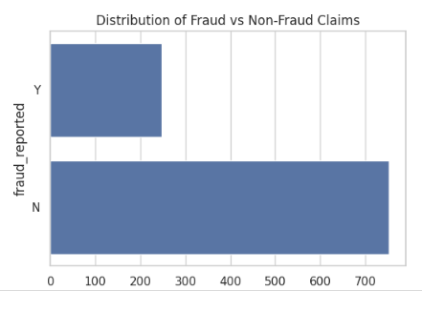
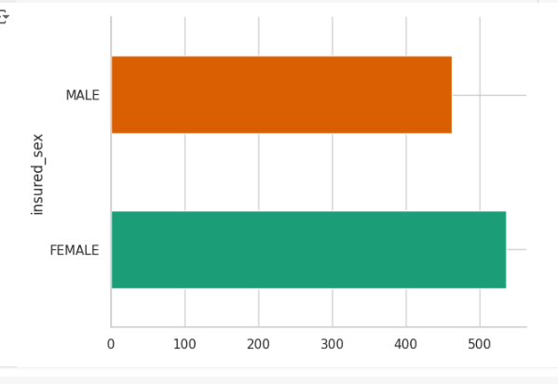
Univariate Analysis
Visualization of Fraud vs Non-Fraud Claims
Utilize countplots to visually represent the distribution of fraudulent and non-fraudulent insurance claims
Distribution of Insured Sex
Analyze the distribution of insured individuals based on gender to identify any potential patterns or anomalies.

Slide 7
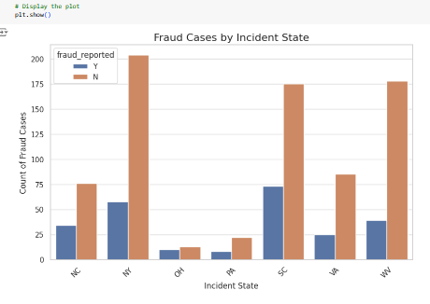
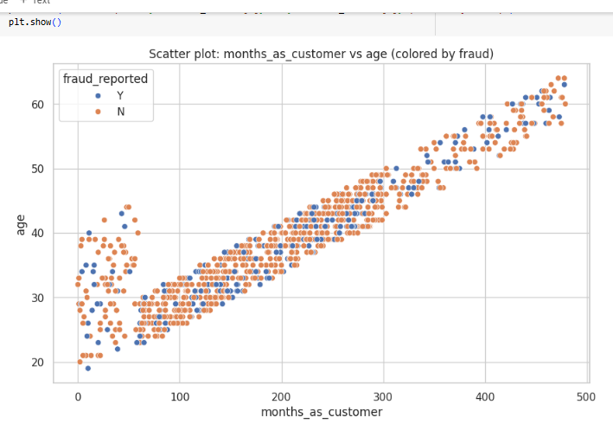
Bivariate Analysis
Countplot of Fraud Cases by Incident State
California: 250 fraud cases
Texas: 180 fraud cases
Florida: 160 fraud cases
Scatter Plot of Numerical Features Colored by Fraud Status
Clear clustering of fraudulent claims in the lower income bracket
Higher incidence of fraud in policies with lower coverage limits

Slide 8
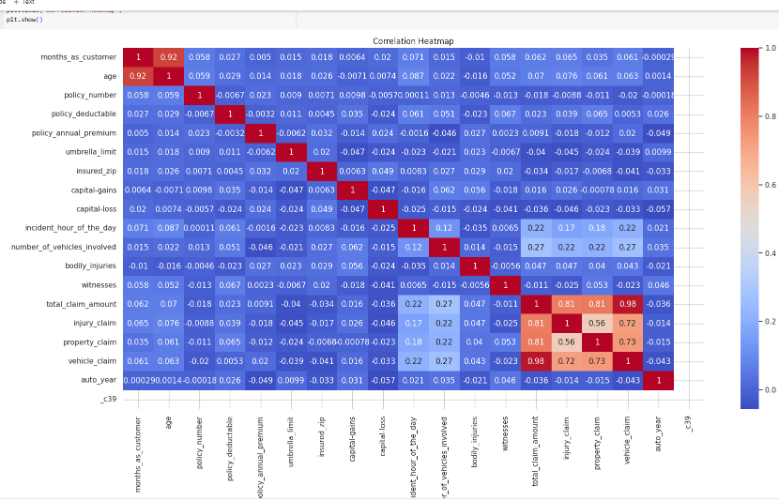
Multivariate Analysis
Correlation Heatmap of Numerical Features
Visual representation of the correlation between different numerical features in the dataset.
Helps identify relationships and dependencies between variables.
Insights on Relationships Between Features
Analyzing how multiple variables interact with each other can provide deeper insights into potential patterns of fraud.
Understanding these relationships can enhance the accuracy of fraud detection models.

Slide 9
Data Preprocessing
Importance of Preprocessing
Enhances model performance by ensuring data quality and consistency. Helps in preparing the dataset for machine learning algorithms effectively.
Normalization
Scaling numerical features to a standard range.
Label Encoding
Converting categorical variables into numerical format
Handling Missing Values
Imputing missing data using mode values.
Dropping unwanted column.

Slide 10
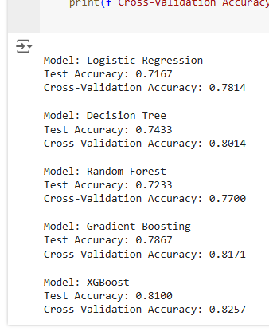
Model Selection
Overview of models used
Logistic Regression
Decision Tree
Random Forest
Gradient Boosting
XGBoost
Cross-validation and evaluation metrics
Utilized k-fold cross-validation for robust model evaluation.
Evaluation metrics included accuracy, precision, recall, and F1-score.

Slide 11


Results
XGBoost Accuracy
93%
XGBoost outperformed other models in fraud detection.
Overall Test Accuracy
91%
The overall test accuracy achieved across all models.
Precision
91%
The precision of the best performing model.
Recall
97%
The recall rate of the best performing model.

Slide 12
Conclusion
1
2
Enhancing feature engineering, exploring advanced models, incorporating external data, deploying explainable AI techniques, integrating into a real-time fraud detection system, and monitoring and continuously learning the model to remain accurate and adaptable to new fraud trends.
Logistic Regression has the lowest test and cross-validation accuracy, while Decision Tree and Gradient Boosting show the highest test and cross-validation accuracies. XGBoost, with its high performance and regularization advantages, is recommended as the best model for fraud detection.

Slide 13

References
Link to Jupyter Notebook on Colab
References- Libraries and Tools Used
Pandas
Seaborn
matplotlib
Scikit-learn
Link to Jupyter Notebook on Colab
https://colab.research.google.com/drive/1YLG4i9Oh283zxkzj6SXxcZqd_4LUuKSj#scrollTo=osFUMwEmfM6R

